Slide 1
Reconstructing the spatial histories of populations from gene trees
James Kitchens
Coop Lab
University of California Davis
jkitchens@ucdavis.edu
james-kitchens.com
@kitchensjn.bsky.social
@kitchensjn.ecoevo.social

Slide 2
Migration
surfaces
Describe variation in migration rates across a landscape often due to topographic features, such as mountains and rivers.
Middle Earth by J.R.R. Tolkein
Digitization by Kaith Menken

Slide 3
Migration
surfaces
Describe variation in migration rates across a landscape often due to topographic features, such as mountains and rivers.
FAST MIGRATION
Middle Earth by J.R.R. Tolkein
Digitization by Kaith Menken

Slide 4
Migration
surfaces
SLOW MIGRATION
Describe variation in migration rates across a landscape often due to topographic features, such as mountains and rivers.
FAST MIGRATION
Middle Earth by J.R.R. Tolkein
Digitization by Kaith Menken

Slide 5
Migration
surfaces
SLOW MIGRATION
Describe variation in migration rates across a landscape often due to topographic features, such as mountains and rivers.
FAST MIGRATION
Previous research:
McCrae 2006
Petkova et al. 2015
Al-Asadi et al. 2019
Marcus et al. 2021
Shastry et al. 2025
Middle Earth by J.R.R. Tolkein
Digitization by Kaith Menken

Slide 6
Gene trees
- Most complete representation of genetic relatedness
- Major advances in inferring gene trees across the genome (Rasmussen et al. 2014, Speidel et al. 2019, Kelleher et al. 2019, Ignatieva et al. 2021, Zhang et al. 2023, Deng et al. 2024)
Recreation of figure from Osmond and Coop 2024
Genome
…
…

Slide 7
Today’s Talk
- Outline method to estimate migration surfaces from gene trees
- Highlight the accuracy of this method using simulations
- Apply method to Wohns et al. 2022 human dataset
- Estimate the locations of lineages back in time
- Discuss future expansions to this method

Slide 8
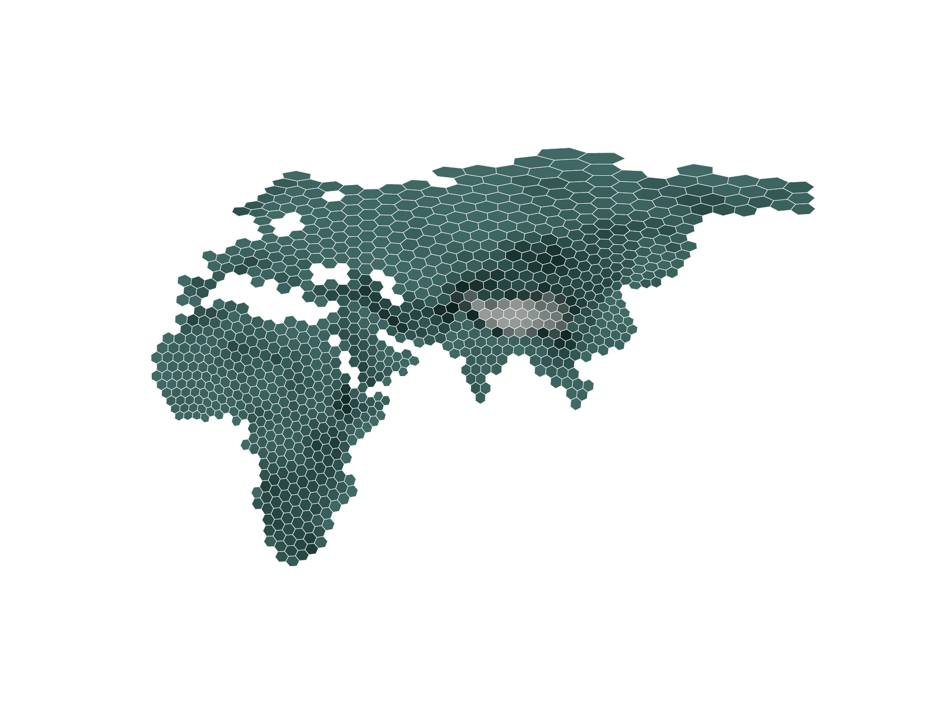
Movement on the map
H3 global grid with average elevation
- Divide the landscape into many discrete demes
- Movement only between neighboring demes
- “Migration surface” is the instantaneous migration rate matrix
Migration rates may vary due to geographic factors

Slide 9



Lineages must be in the same deme to coalesce
The genetic relationships between samples (trees) inform us about the past movement of lineages
L
M
R
$$×$$
$$×$$
R
A
$$=$$
L
M
A
Less likely
More likely

Slide 10
Likelihood of tree given migration surface
- Felsenstein’s pruning algorithm
- Builds off ideas previously applied to single trees from non-recombining regions, such as mtDNA and Y-chromosome (Avise 2009, Knowles 2009)

Slide 11
Sparsely sample trees across genome
Recreation of figure from Osmond and Coop 2024
Genome
…
…
Determine the migration surface which maximizes the composite likelihood across all the trees using hill-climbing

Slide 12
Simplifications to speed up search
- Discretizing node times in the gene trees

Slide 13
Simplifications to speed up search
- Working only with symmetrical migration
- Grouping demes and transitions into “types”
Three Deme Types
Two Deme Types
One Deme Type
:
:
:

Slide 14
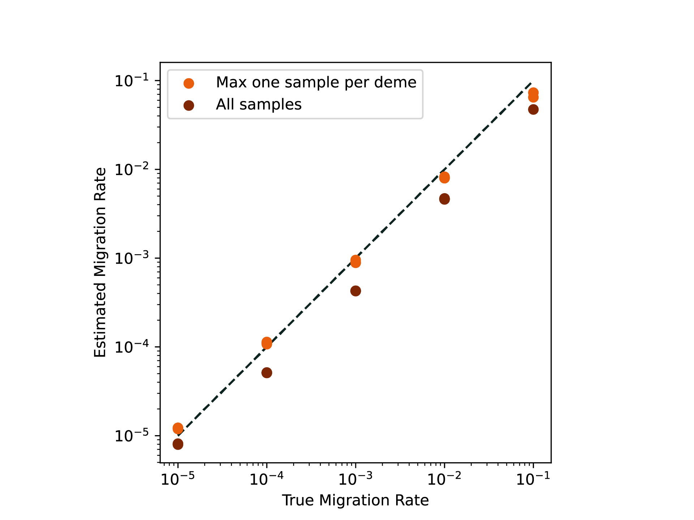
Simulations
Using 1906 sample locations in Africa, Asia, and Europe (Wohns et al. 2022), we generated 100 independent trees under various single migration rate scenarios with msprime (Kelleher et al. 2016).
Estimates track closely with true rates in these scenarios as well as for more complex surfaces (not shown).

Slide 15
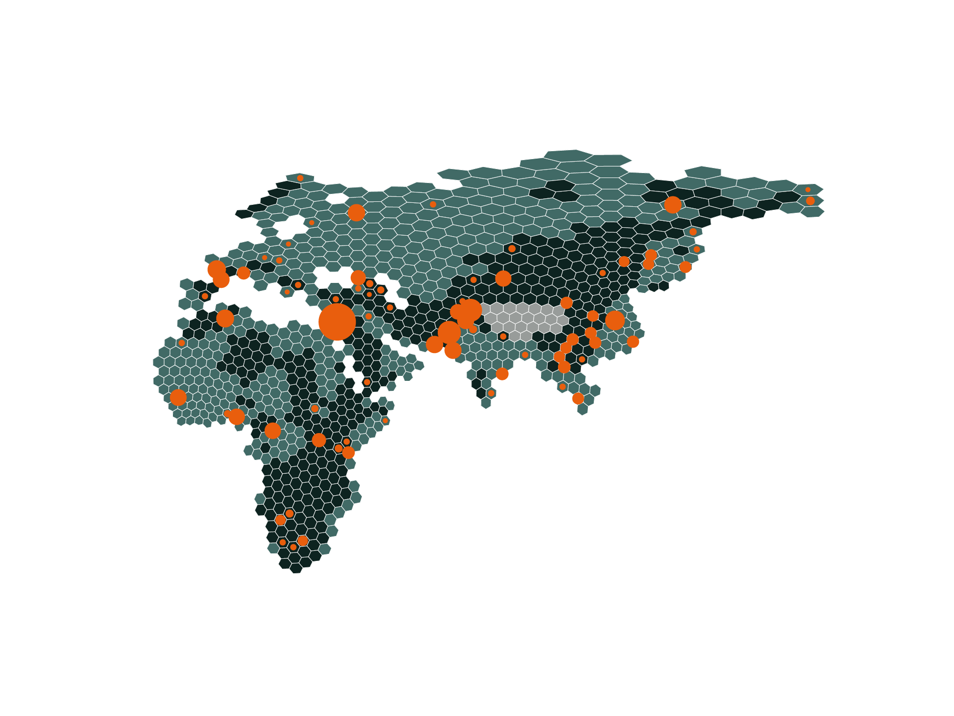
Applying to human dataset
We assigned deme type based on the average elevation within each deme and estimated three migration rates (one for each deme type) using 104 trees sparsely sampled trees from chromosome 17p for the 1906 samples from Africa, Asia, and Europe (Wohns et al. 2022).
Samples
Average Elevation
Low (<500m)
Middle (500 to 4000m)
High (>4000m)
Note: Elevation is used for this example, but deme type could be assigned by any metric.

Slide 16
Applying to human dataset
We assigned deme type based on the average elevation within each deme and estimated three migration rates (one for each deme type) using 104 trees sparsely sampled trees from chromosome 17p for the 1906 samples from Africa, Asia, and Europe (Wohns et al. 2022).
Samples
Average Elevation
Low (<500m)
Middle (500 to 4000m)
High (>4000m)
Estimated Rates | 4.32e-3 | 4.95e-2 | 0

Slide 17
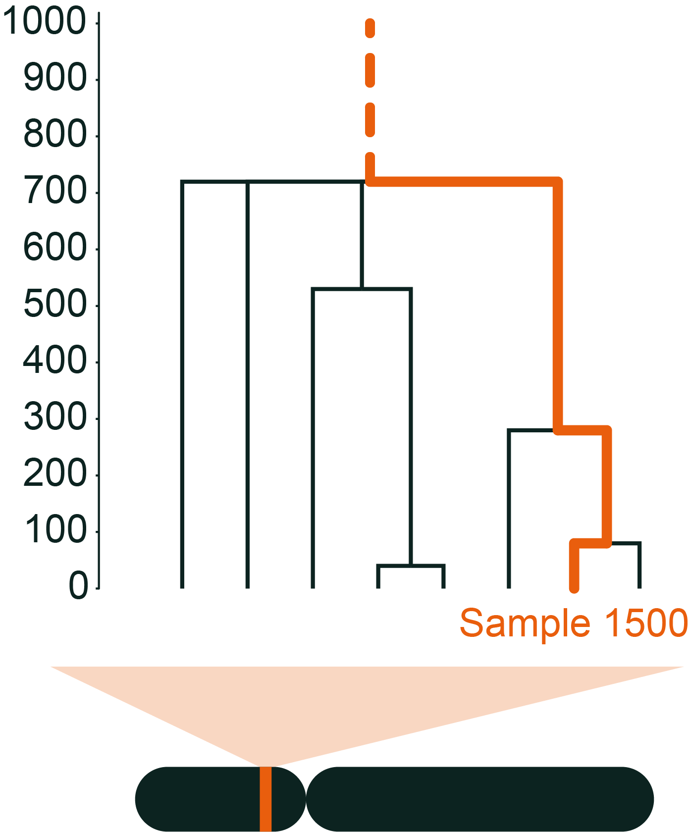
Tracking ancestral lineages
Using the genome-wide MLE migration surface, we estimated the locations of ancestors from a single gene tree, accounting for uncertainty from the movement model
*deeper connections
to other samples
Generations In Past
Chromosome 17
Interval 19,546,431-19,547,824
*chromosome not to scale

Slide 18
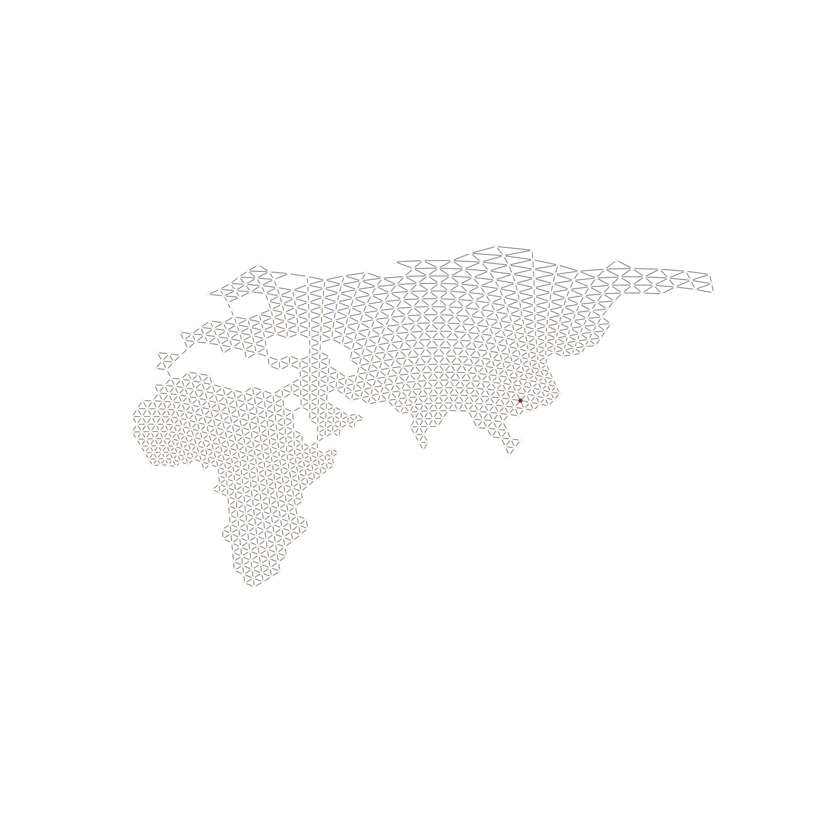
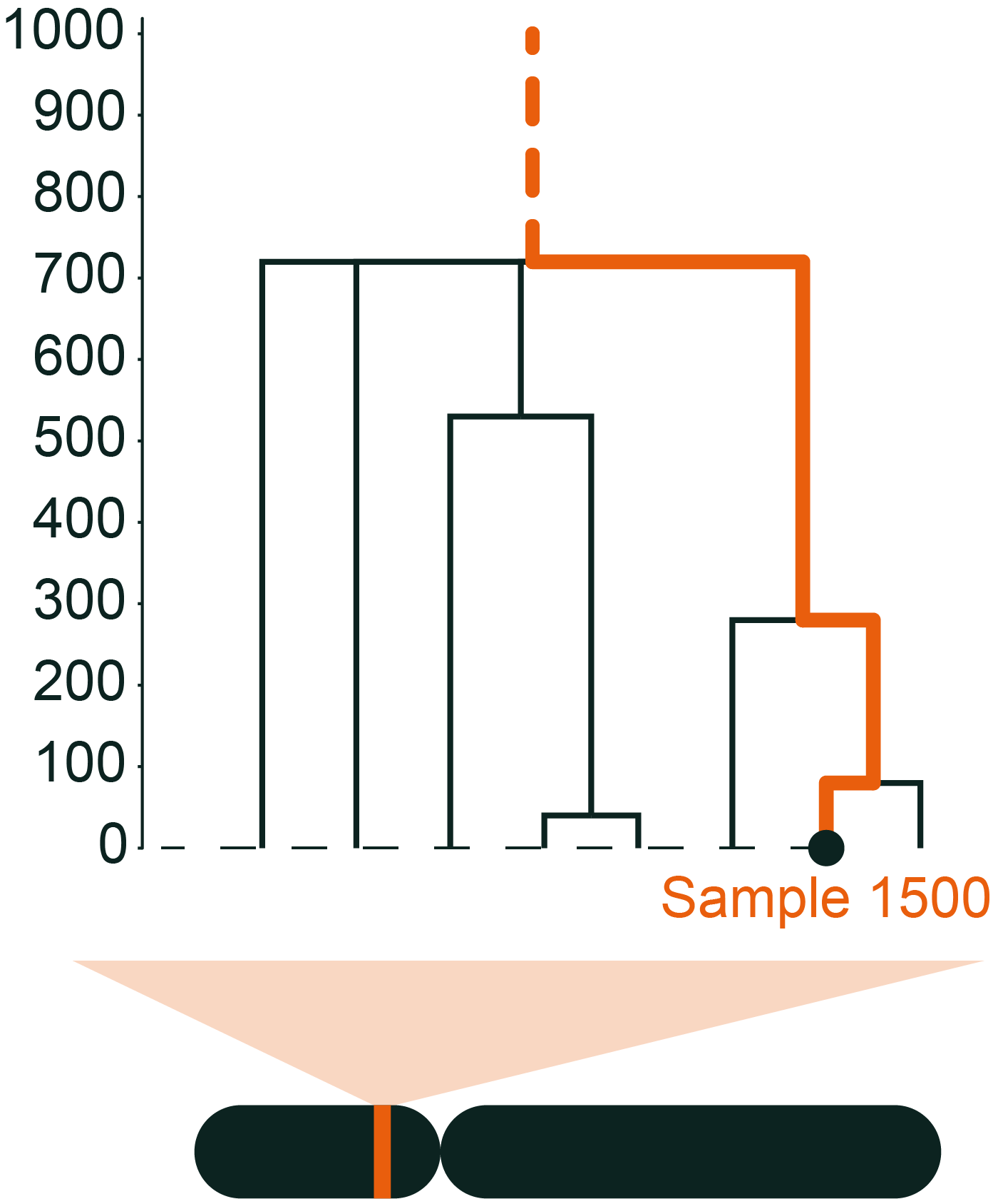
Tracking ancestral lineages
Using the genome-wide MLE migration surface, we estimated the locations of ancestors from a single gene tree, accounting for uncertainty from the movement model
*deeper connections
to other samples
Generations In Past
Starting position
Less likely
More likely
Chromosome 17
Interval 19,546,431-19,547,824
*chromosome not to scale

Slide 19
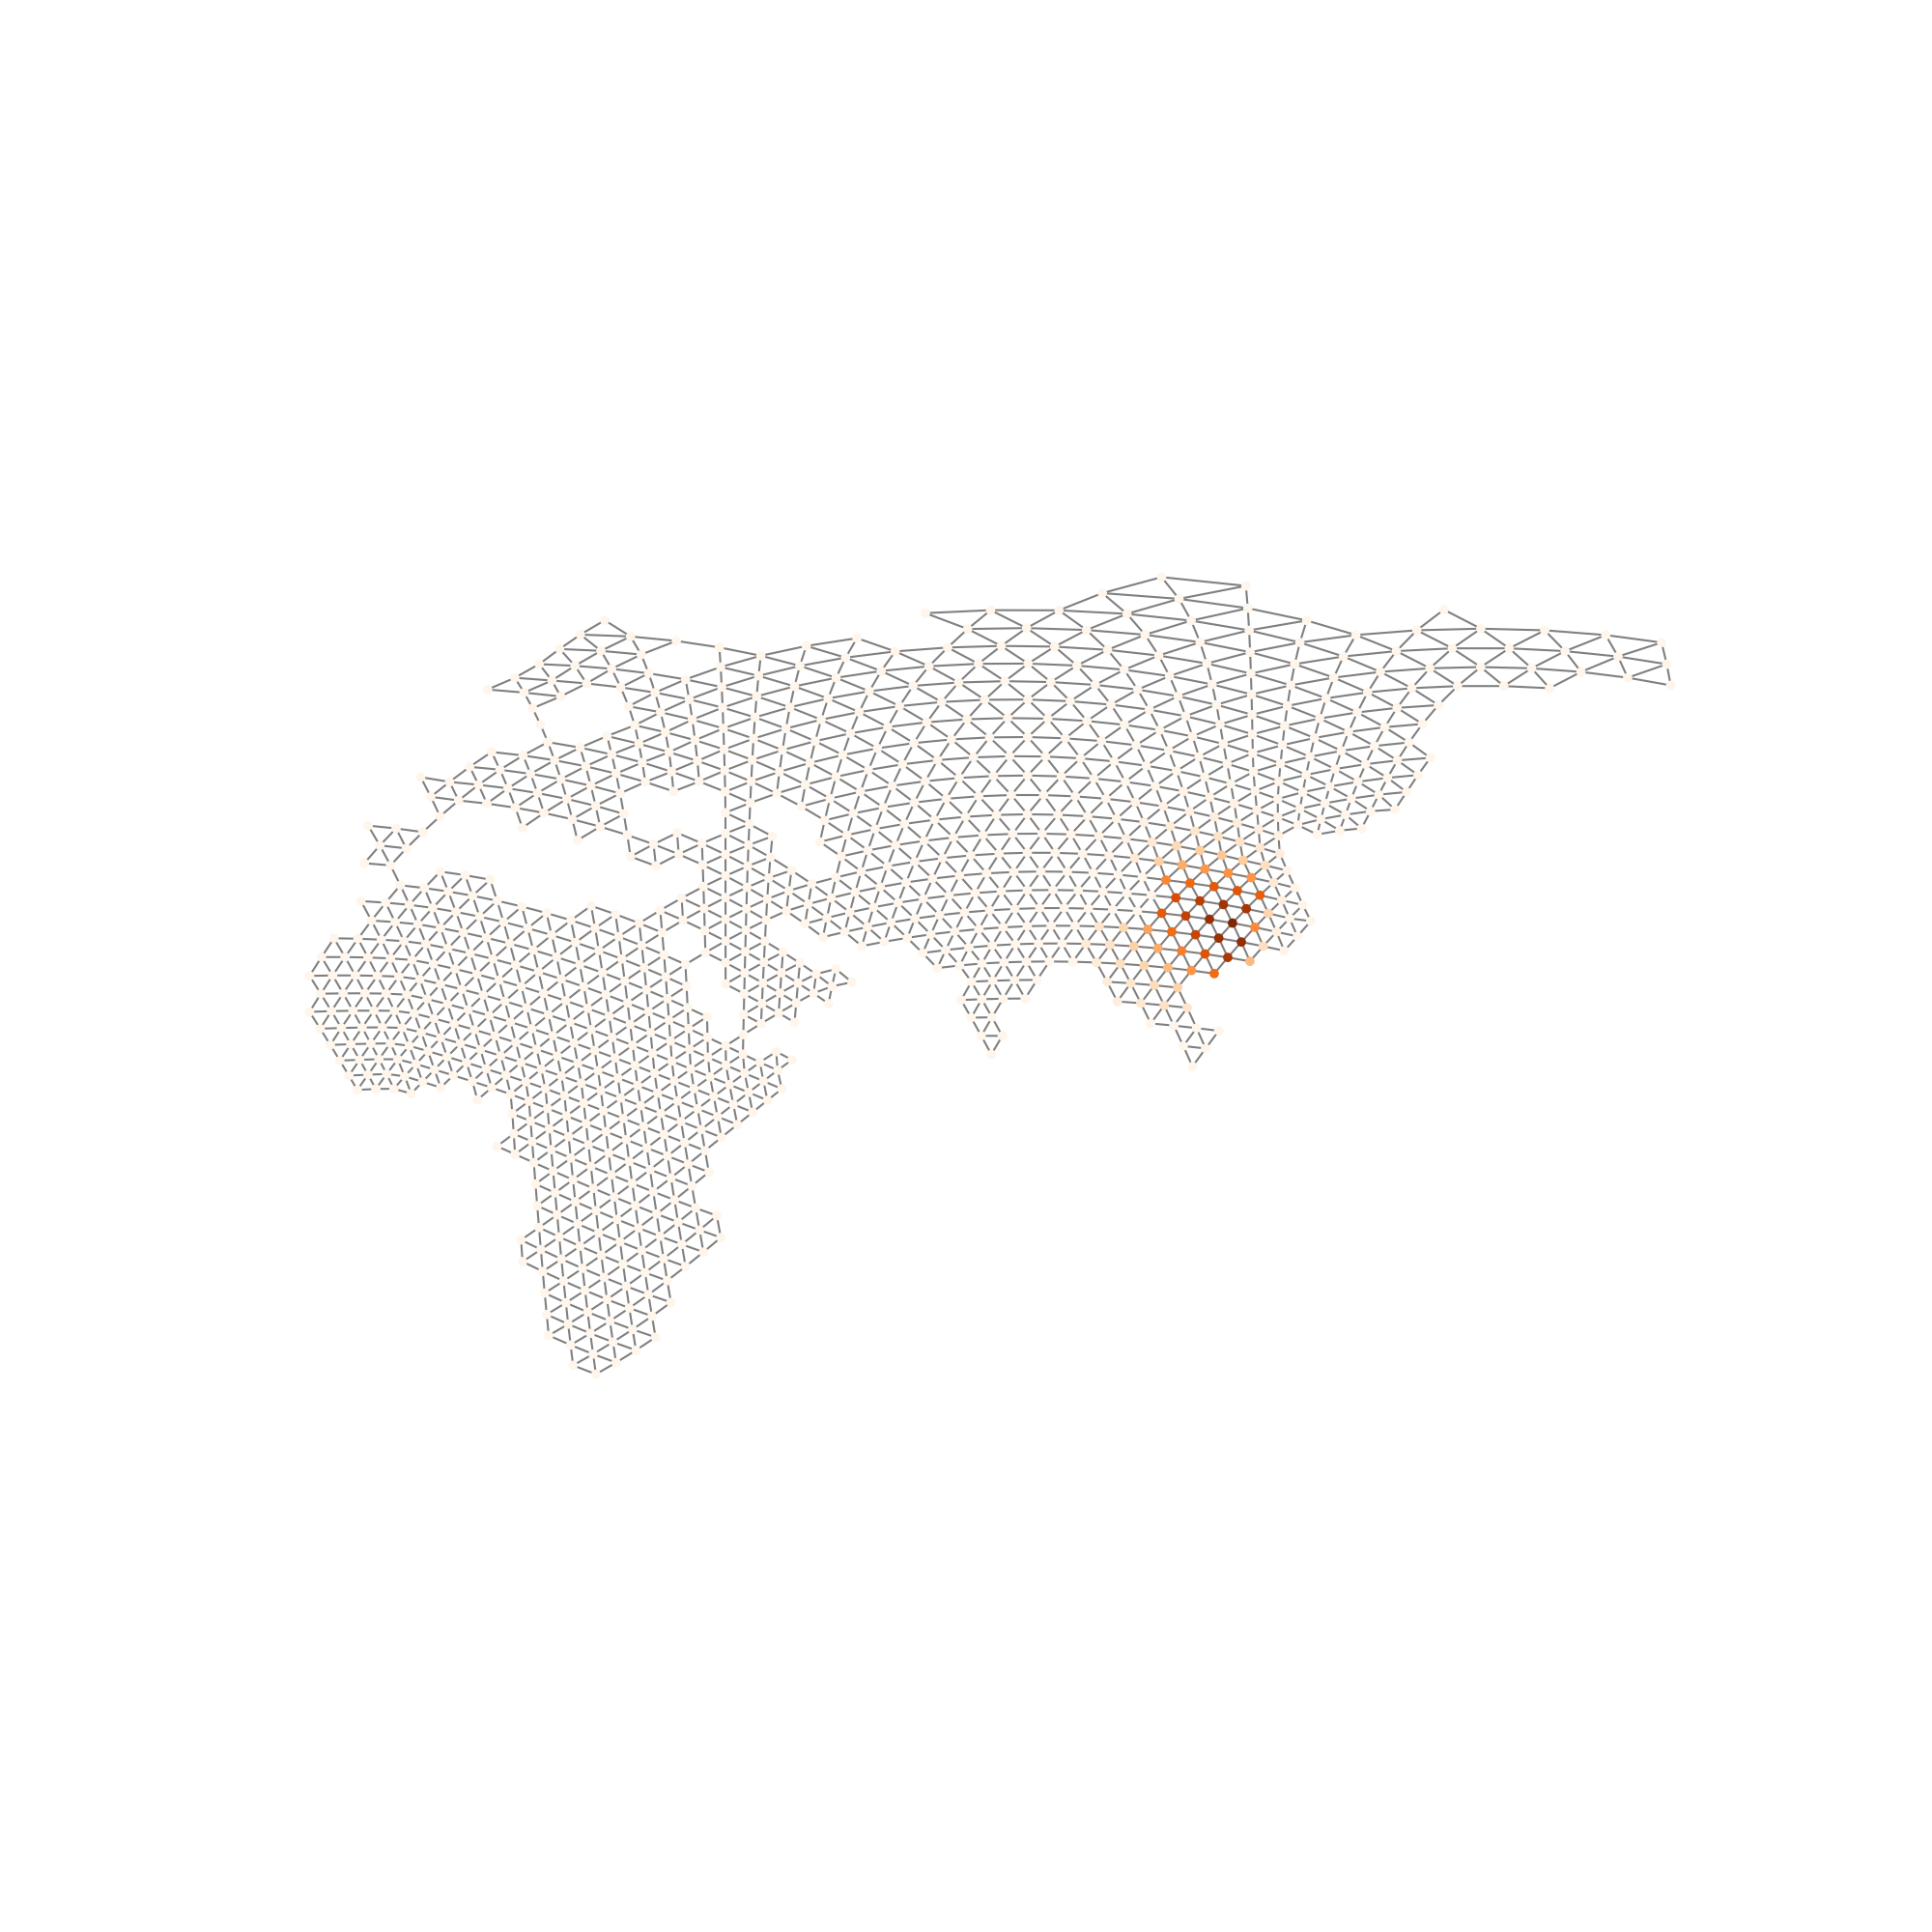
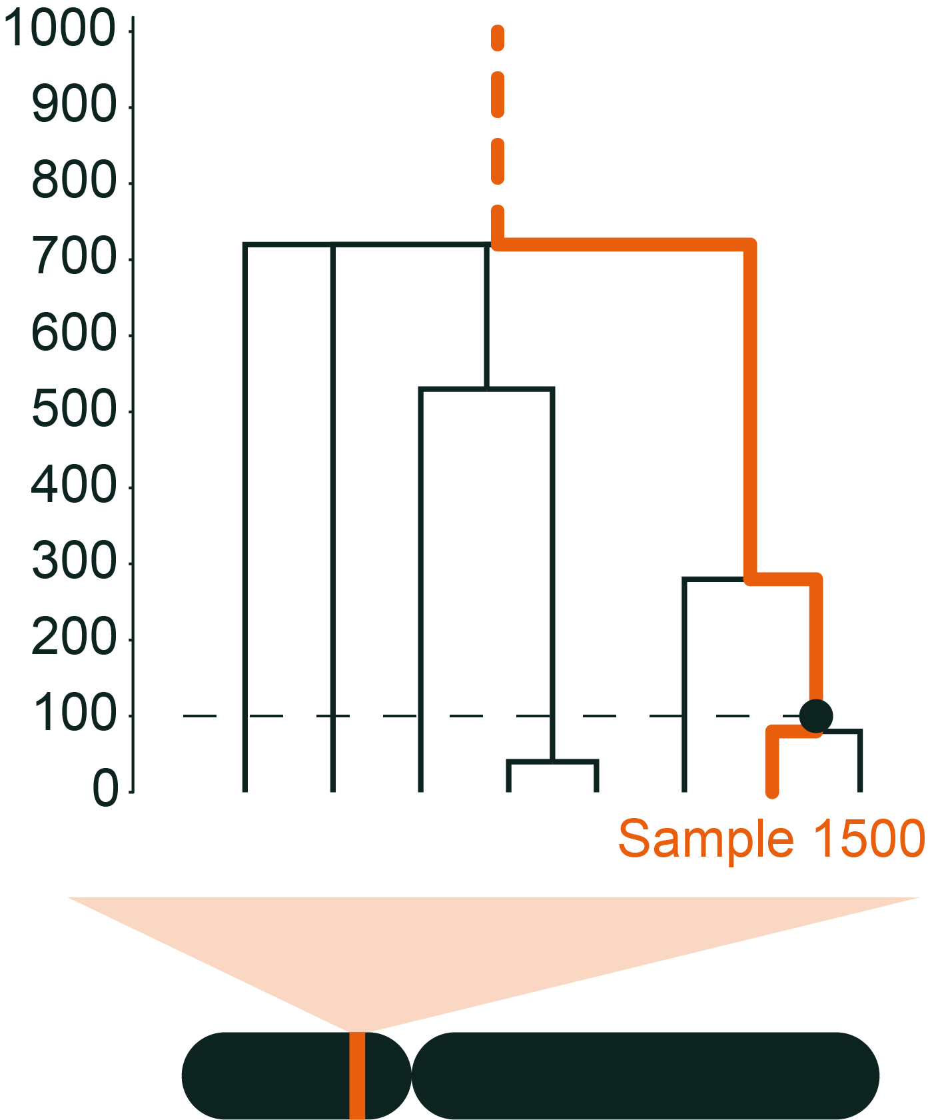
Tracking ancestral lineages
Using the genome-wide MLE migration surface, we estimated the locations of ancestors from a single gene tree, accounting for uncertainty from the movement model
*deeper connections
to other samples
Generations In Past
Less likely
More likely
Chromosome 17
Interval 19,546,431-19,547,824
*chromosome not to scale

Slide 20


Tracking ancestral lineages
Using the genome-wide MLE migration surface, we estimated the locations of ancestors from a single gene tree, accounting for uncertainty from the movement model
*deeper connections
to other samples
Generations In Past
Less likely
More likely
Chromosome 17
Interval 19,546,431-19,547,824
*chromosome not to scale

Slide 21
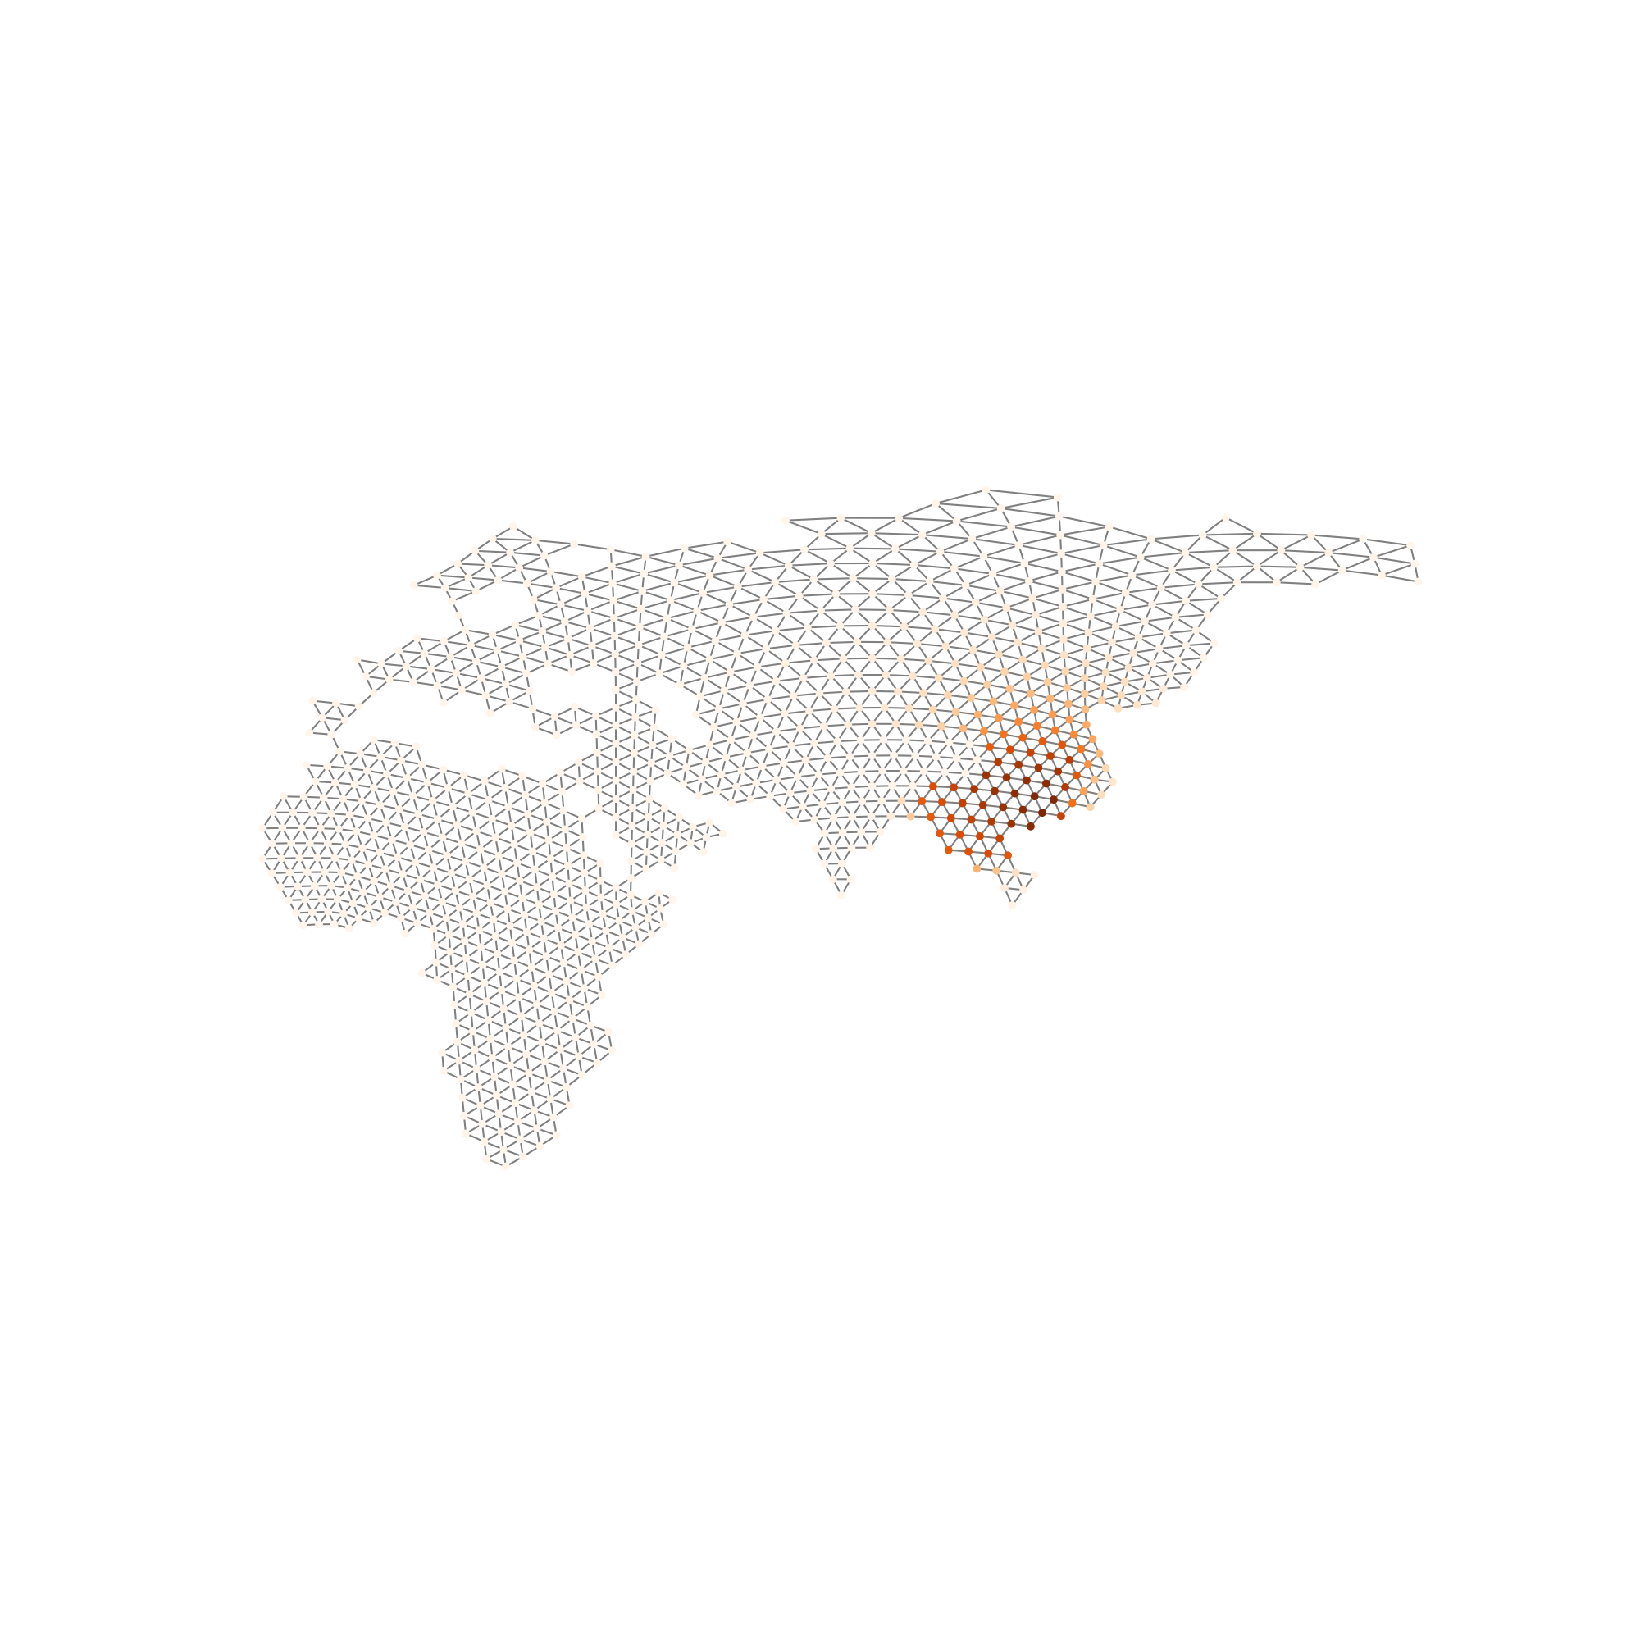

Tracking ancestral lineages
Using the genome-wide MLE migration surface, we estimated the locations of ancestors from a single gene tree, accounting for uncertainty from the movement model
*deeper connections
to other samples
Generations In Past
Less likely
More likely
Chromosome 17
Interval 19,546,431-19,547,824
*chromosome not to scale

Slide 22
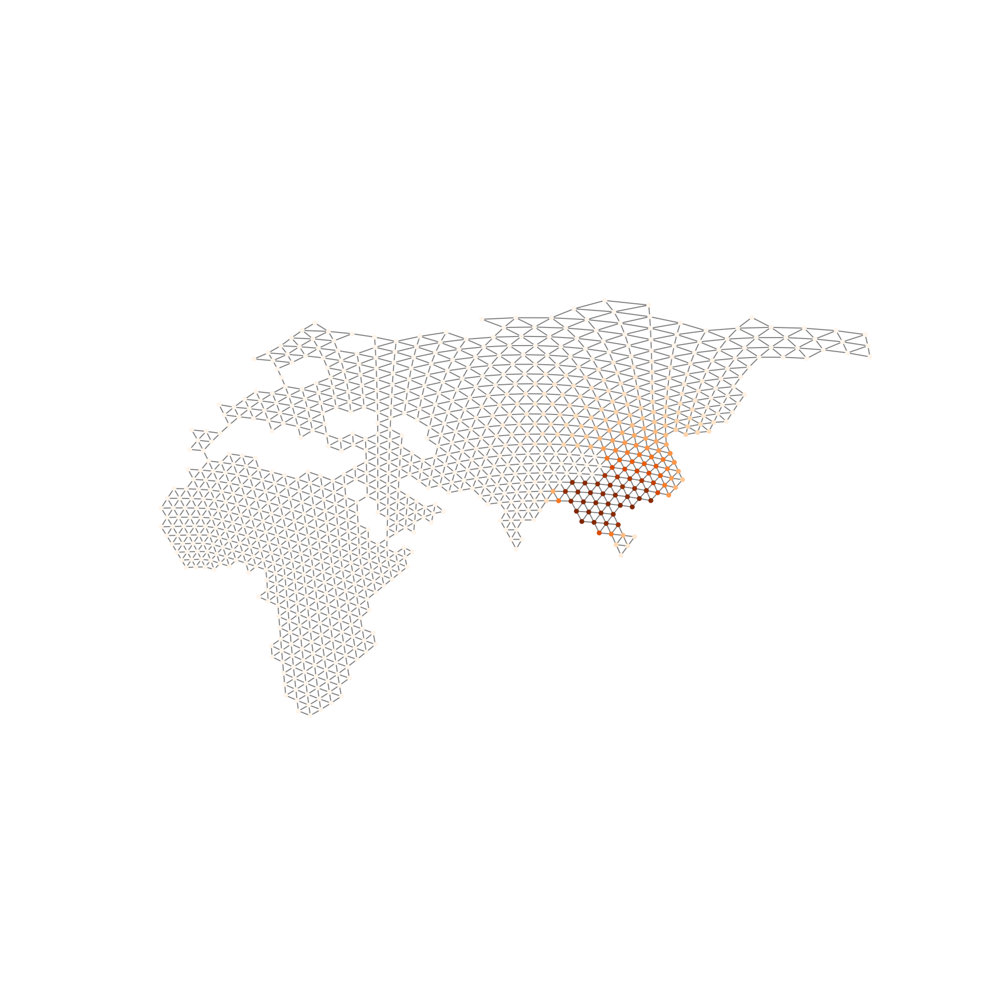

Tracking ancestral lineages
Using the genome-wide MLE migration surface, we estimated the locations of ancestors from a single gene tree, accounting for uncertainty from the movement model
*deeper connections
to other samples
Generations In Past
Less likely
More likely
Chromosome 17
Interval 19,546,431-19,547,824
*chromosome not to scale

Slide 23
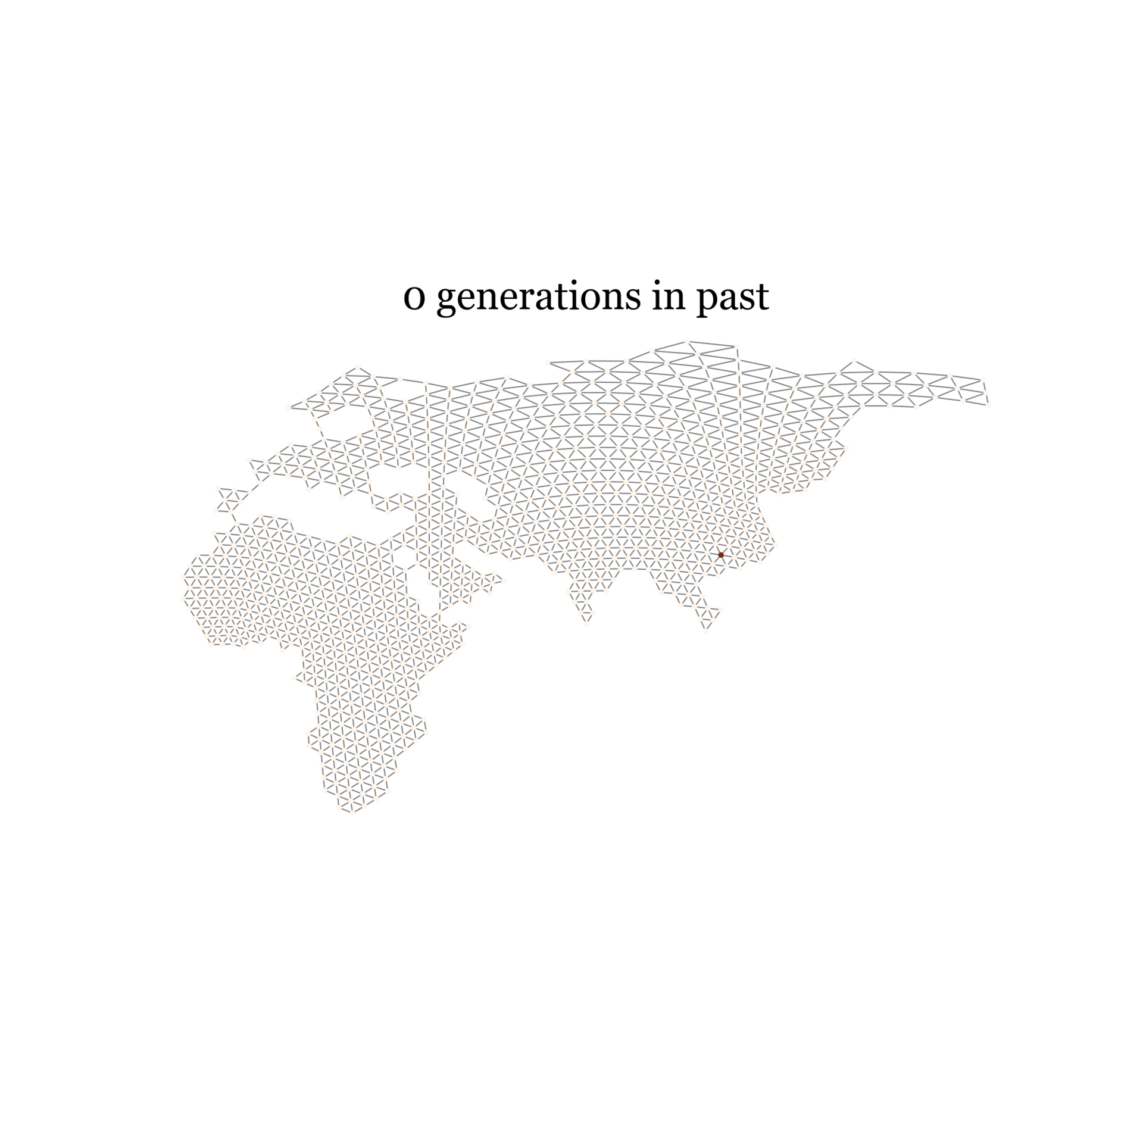
Less likely
More likely
Tracking Chromosome 17p:19,546,431-19,547,824 on of Sample 1500

Slide 24
Future Directions
- Creating tools for identifying critical elements driving estimates
- Allowing for the migration rates to change over time
- Allowing deme type assignments to be updated by data
- Applying this method to cool systems!

Slide 25



Acknowledgements
Graham Coop
Jeff Groh
Sam Snodgrass
Gabriele Sgarlata
Puneeth Deraje
Julia Harencar
Population Biology Graduate Group and Center for Population Biology at UC Davis
National Institutes of Health (NIH R35 GM136290)

Slide 26
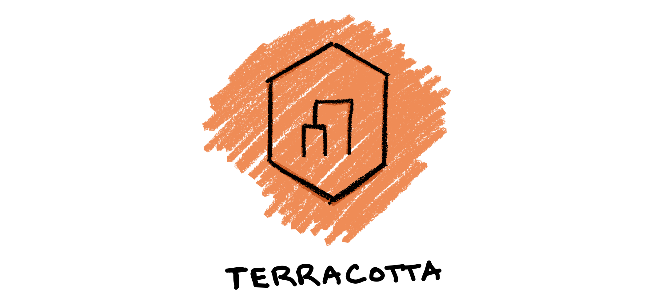
Questions?
Method in active (early) development at
https://github.com/kitchensjn/terracotta.
Open to feature requests and suggestions through GitHub Issues.
jkitchens@ucdavis.edu
james-kitchens.com
@kitchensjn.bsky.social
@kitchensjn.ecoevo.social

